Slide 1
Feedback

Slide 2
Release
Releases.
I want to have a first release following the completion of the following functions. These will be limited to the Administrative user.
1. Product Management
2. Company Management
3. User Mgmt.
4. Scheduler.
Following that it will be to External/Internal users.

Slide 3
Company

Slide 4
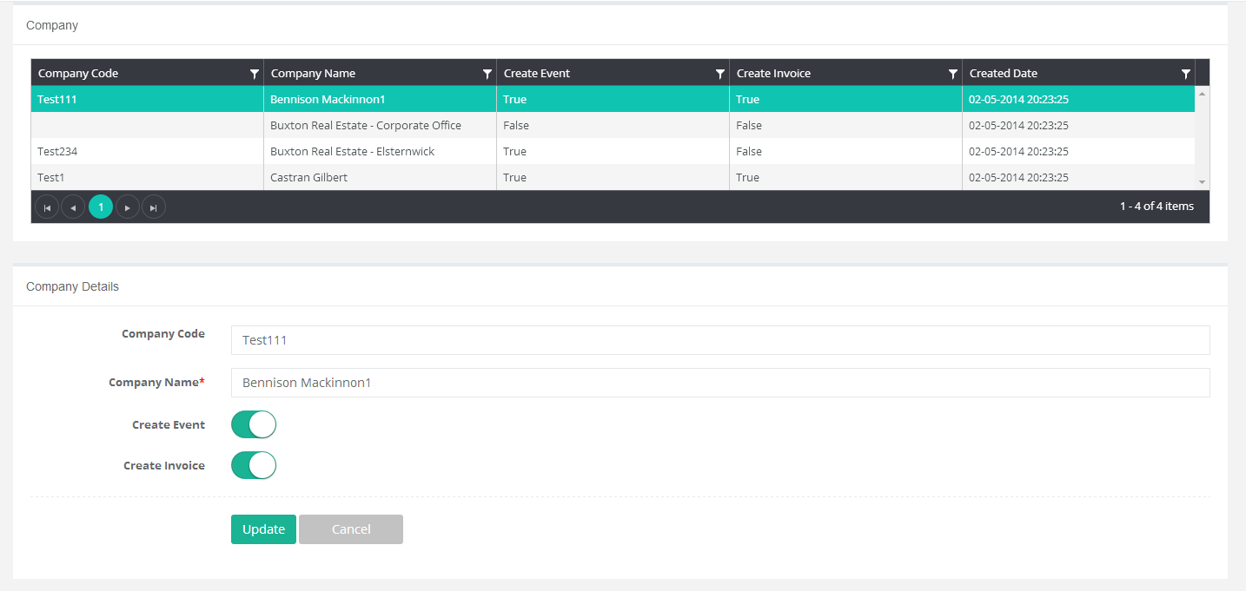
Because all the companies are synchronised from XERO, and many are not clients who will order through this platform we should add a new field called “Active” bit. Then constrain this list to only return Active = 1 records. This field will be managed in the backend not on the front end.

Slide 5
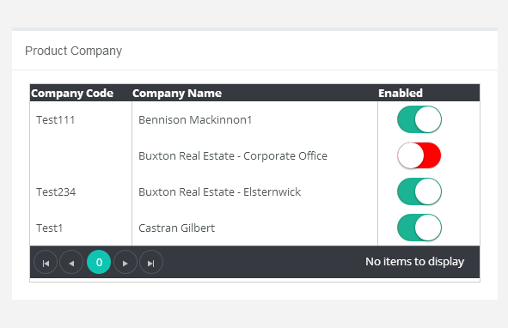
Change this List to only return Company where Active = 1

Slide 6
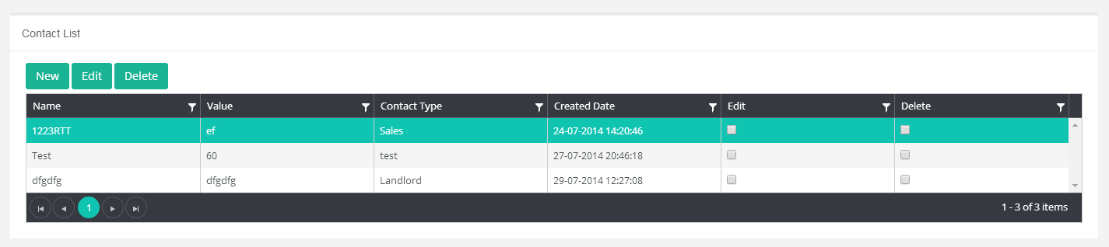
Remove the Edit/Delete checkbox from the grid.

Slide 7
Product Schedule.

Slide 8
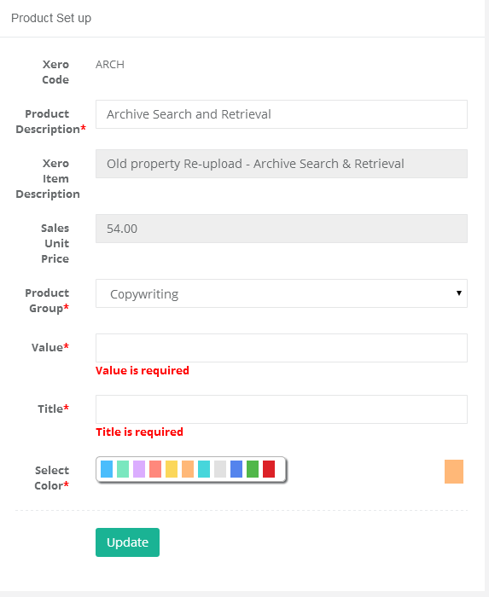
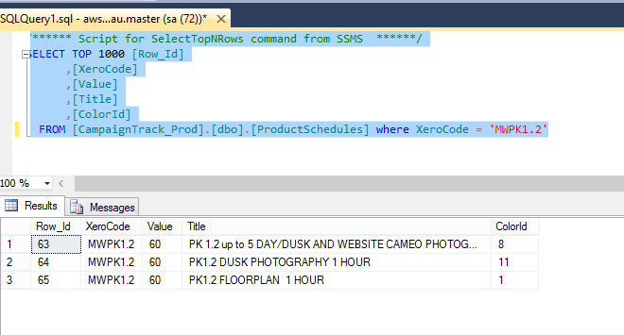
We need to move these 3 fields into a list. Its possible to have 1 XERO code with multiple product schedule records as depicted here. The example below means that each time this product is ordered, 3 events will be created in the Google Calendar that require scheduling.

Slide 9
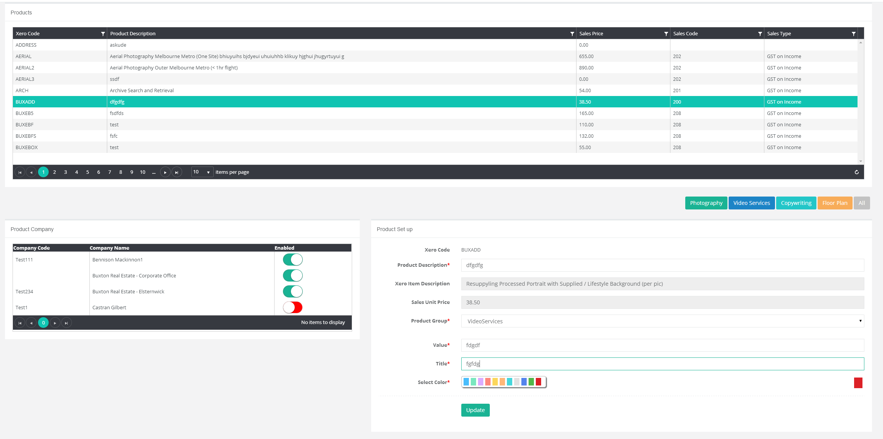
New
Edit
Delete
Value
Title
Colour

Slide 10
Scheduler

Slide 11
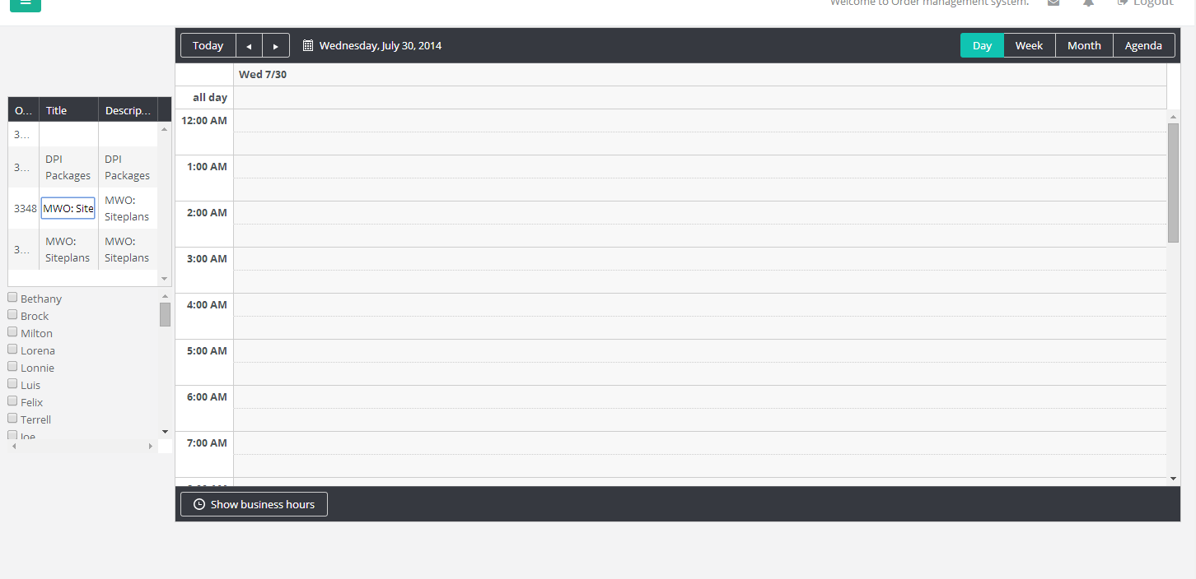
We don’t need 3 columns, just display the title field.

